Slide 1
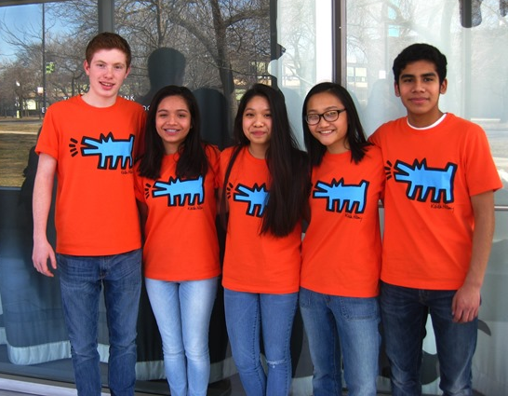
STUDENTS BECOME HISTORIANS WHEN THEY . . .
Ask HISTORICAL QUESTIONS about a topic that interests them.
Do RESEARCH using books by historians and primary sources.
ANALYZE, COME TO CONCLUSIONS, AND MAKE ARGUMENTS supported by evidence.
Produce PROJECTS to present to the public.
. . . DO HISTORY FAIR!
Chicago Metro History Fair Revised 2017

Slide 2
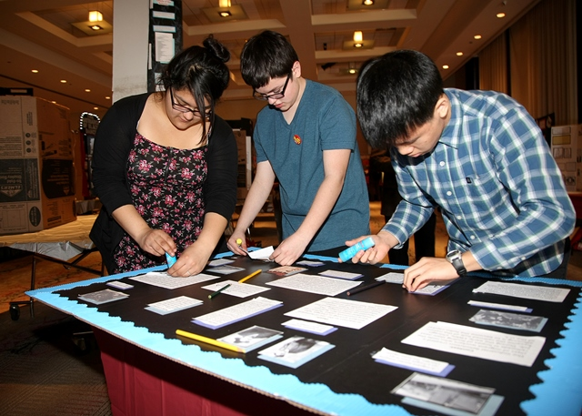
Students become
museum curators and designers,

Slide 3
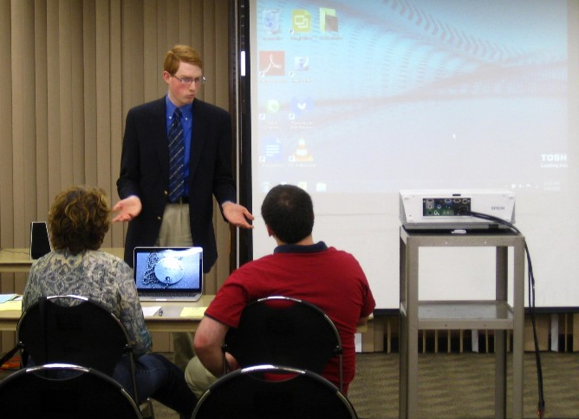
. . . documentary filmmakers,

Slide 4
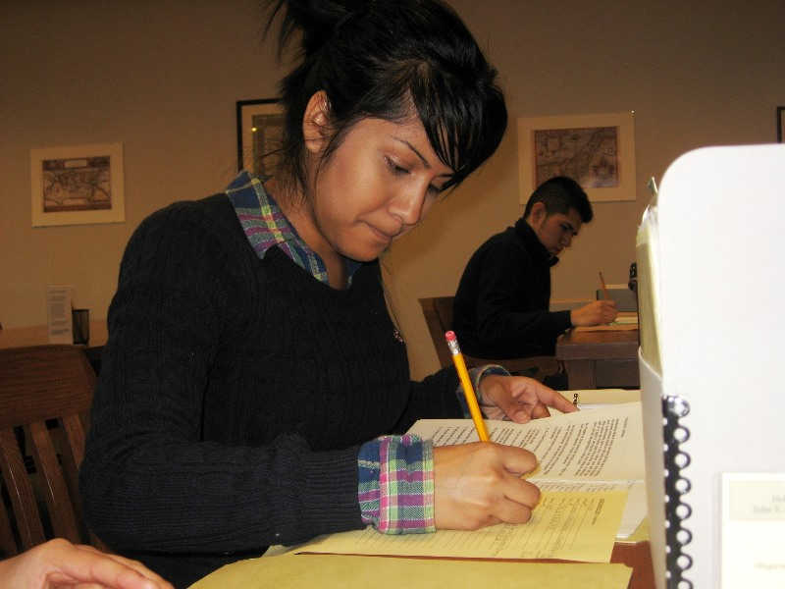
. . . scholars writing for a journal,

Slide 5
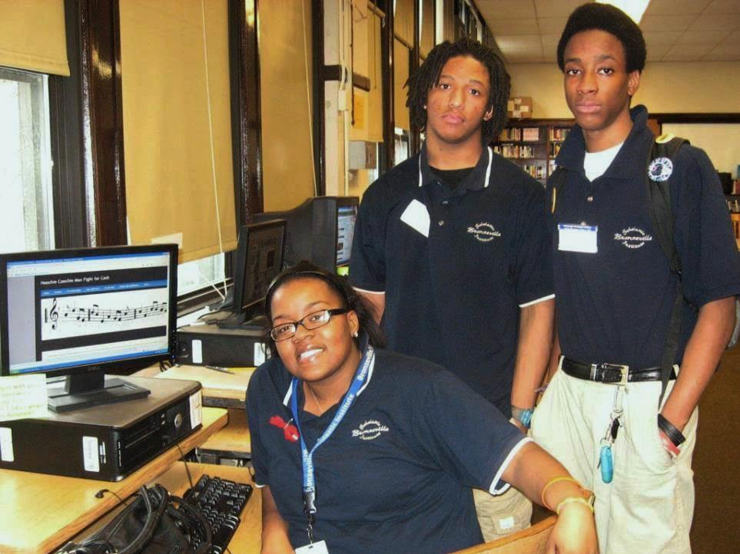
. . . website developers,

Slide 6
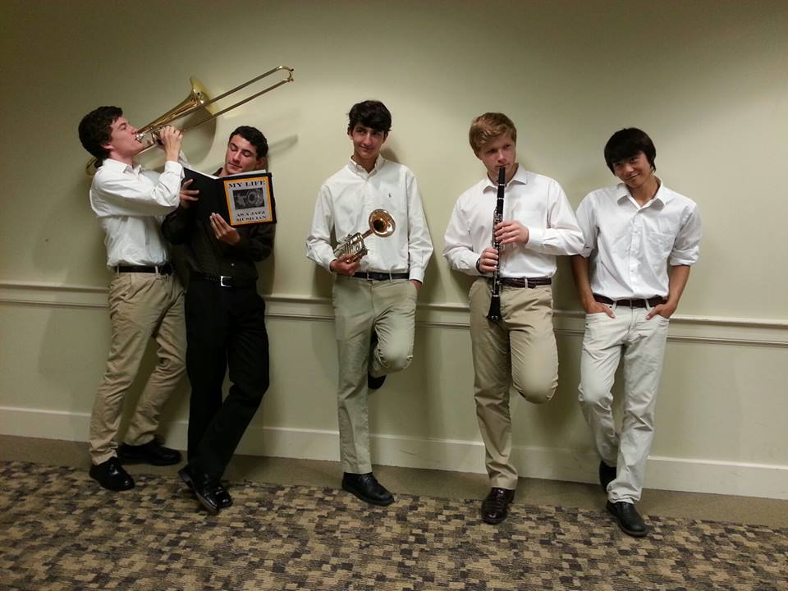
. . . and performers.

Slide 7
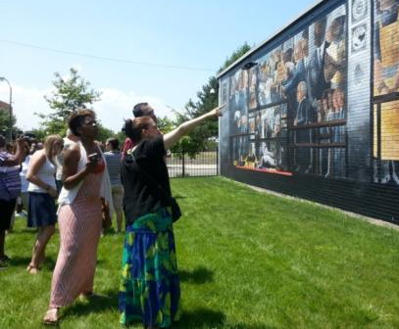
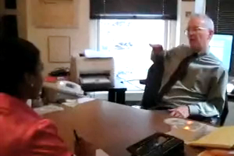
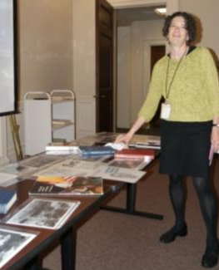
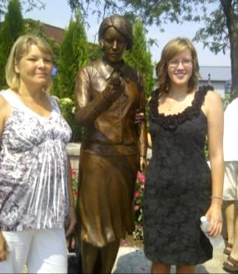
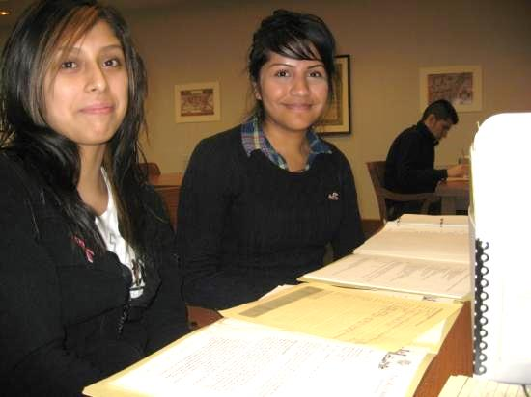
History Fair is more than an assignment – it is an experience!

Slide 8
Five Steps for a Successful History Fair Project
1.
Ask Questions & Find Your Topic
3.
Analyze Your Sources
4.
Develop an Argument
5.
Tell Us Your Story!
2.
Take the Research Journey

Slide 9
Step 1
?
?
?
I wonder why . . .
?
1.
Ask Questions & Find Your Topic

Slide 10
There are many ways to find topics . . .
What topics interest you?
Immigration, Ethnicity
Politics, Law
Labor, business
Technology, medicine
Arts, literature
Sports, Media
Civil and human rights
Women’s issues
Environment
— everything has a history!
What current events or issues concern you?
What career do you want to have as an adult?
What period of history is most intriguing for you?
1. Ask Questions & Find Your Topic

Slide 11
. . . or consider the BIG questions that YOU especially care about:
How do the arts change society?
How do people gain rights and share power?
What happens to people, communities, nations in times of war?
How do music, sports, dance, or writing impact history?
How did my community get this way?
What do people do when the economy changes?
1. Ask Questions & Find Your Topic

Slide 12
Where you can look for ideas . . .
Archives’ & special collections’ finding aids
Encyclopedia of Chicago, Chicago History, other Chicago-based publications
Museums & cultural organizations
Newspapers & magazines
Your history book
Talk to people!



·

1. Ask Questions & Find Your Topic

Slide 13
Make sure those ideas are History Fair-ready
It can be argued or interpreted.
It’s history – happened in the past , and shows change over time.
It’s historically significant.
It’s connected to Chicago or Illinois.
Your History Fair Topic Question
It’s got soul! YOU CARE ABOUT IT!
It’s got sources for evidence.
It uses the NHD theme for analysis.
1. Ask Questions & Find Your Topic

Slide 14



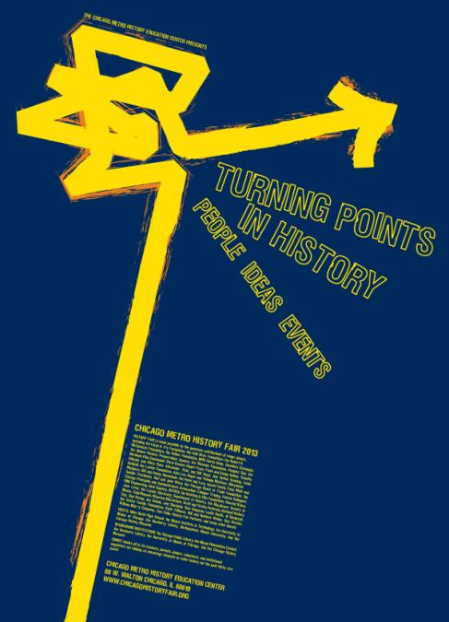
Each year, National History Day offers a theme to use with your topic.
WHAT IS THIS YEAR’S NHD THEME?
1. Ask Questions & Find Your Topic

Slide 15
The following exhibits from previous years show how your interests and topic ideas usually can connect to the current theme . . .
1. Ask Questions & Find Your Topic

Slide 16
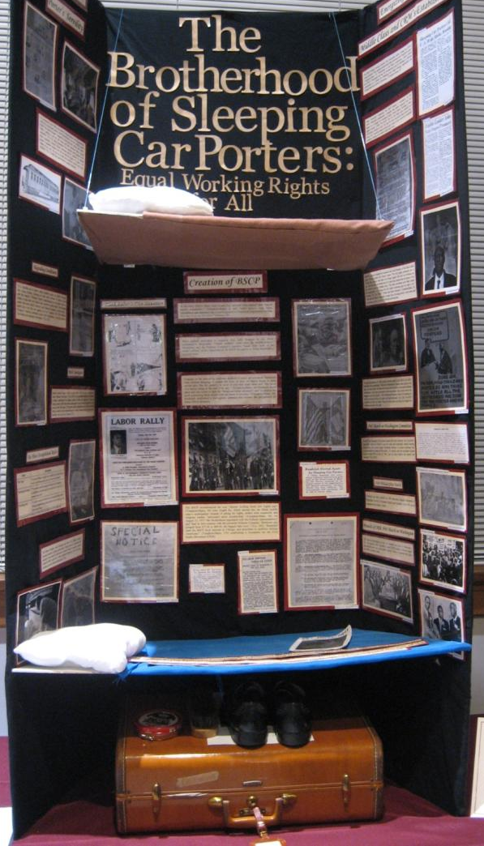
“Revolution, Reaction, and Reform”
1. Ask Questions & Find Your Topic

Slide 17
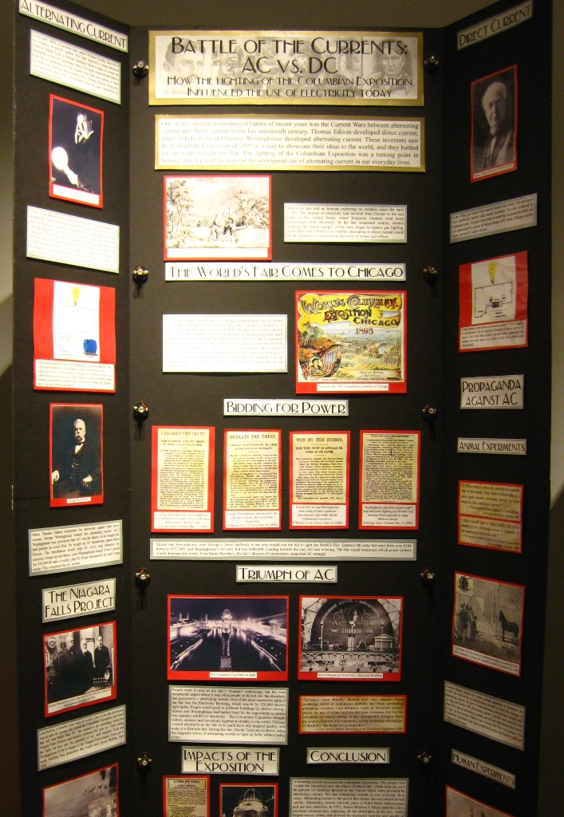
“Turning Points in History”
1. Ask Questions & Find Your Topic

Slide 18
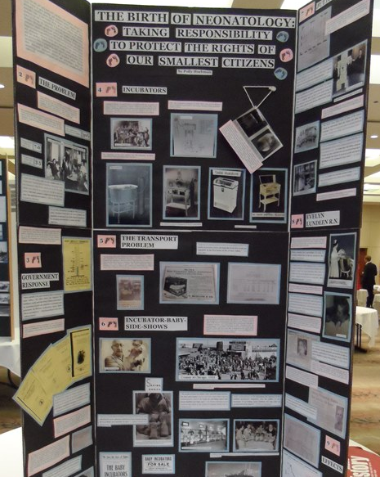
“Rights and Responsibilities”
1. Ask Questions & Find Your Topic

Slide 19
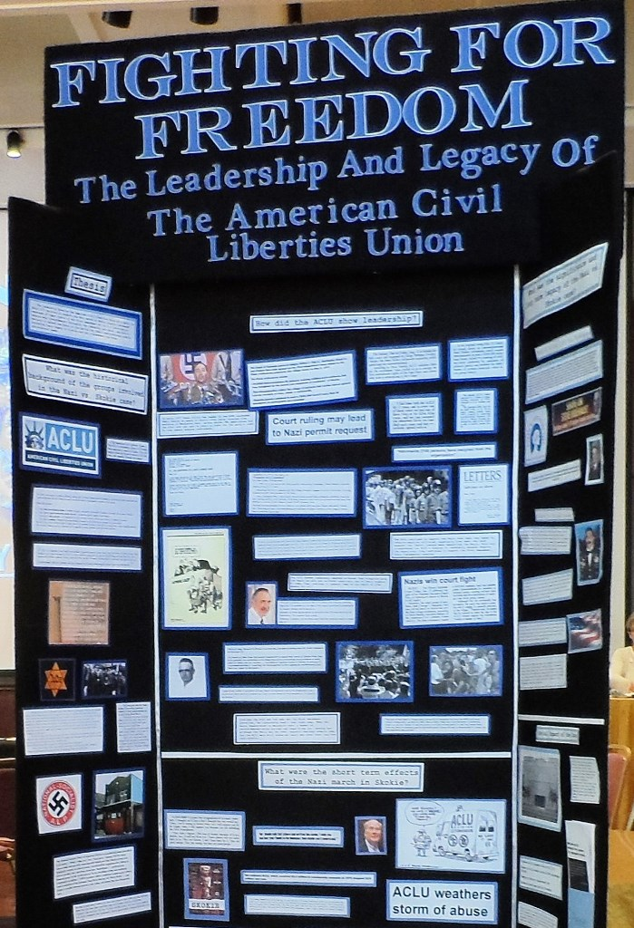
“Leadership and Legacy”
1. Ask Questions & Find Your Topic

Slide 20

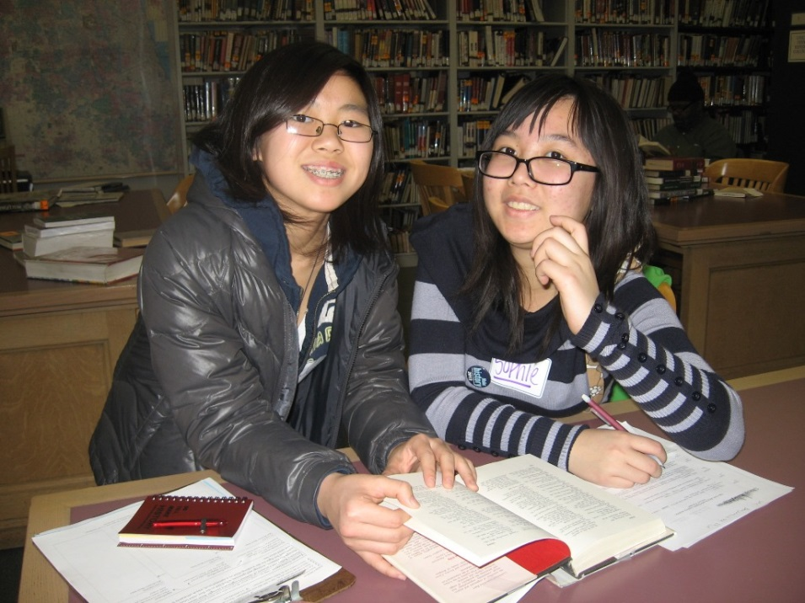
Step 2
What does History Fair research look like?
2. Take the Research Journey

Slide 21

Research is a journey.
You start it when you seek a topic and question and then go further to develop your thesis and argument.
2. Take the Research Journey

Slide 22
INVEST TIME IN FINDING THE TOPIC
What changed? How and why? What was the impact? What was its significance?
Always the “big questions” of history.
ANNUAL NHD THEME
A specific aspect of history to analyze. The theme is broad so may topics are relevant.
Research!
2. Take the Research Journey

Slide 23
INVEST TIME IN FINDING THE TOPIC
What changed? How and why? What was the impact? What was its significance?
Always the “big questions” of history.
NHD THEME
The specific aspect of history to analyze. For example, “Turning Points in History.”
BROAD TOPIC
I love TV! I’ll explore that topic.
Research!
2. Take the Research Journey

Slide 24
INVEST TIME IN FINDING THE TOPIC
What changed? How and why? What was the impact? What was its significance?
Always the “big questions” of history.
A specific aspect of history to analyze. The theme is broad so may topics are relevant.
NHD THEME
A specific aspect of history to analyze.
BROAD TOPIC
I love TV ! I’ll explore that topic.
Narrowed Topic
Hey, I didn’t know that Chicago was once famous for its television programs. Wow!
Research!
2. Take the Research Journey

Slide 25
INVEST TIME IN FINDING THE TOPIC
What changed? How and why? What was the impact? What was its significance?
Always the “big questions” of history.
NHD THEME
The specific aspect of history to analyze. For example, “Turning Points in History”
BROAD TOPIC
I love TV! I’ll explore that topic.
Narrowed Topic
Hey, I didn’t know that Chicago was once famous for its television programs. Wow!
Historical Question
Did early Chicago TV produce any turning points in history?
Research!
2. Take the Research Journey

Slide 26
INVEST TIME IN FINDING THE TOPIC
What changed? How and why? What was the impact? What was its significance?
Always the “big questions” of history.
NHD THEME
The specific aspect of history to analyze. For example, “Turning Points in History.”
BROAD TOPIC
I love TV !
Narrowed Topic
Hey, I didn’t know that Chicago was once famous for its television programs. Wow!
Historical Question
Did early Chicago TV produce any turning points in history?
Research!
“Working” or “Draft” Thesis
The Chicago School of Television created a unique style that changed how people viewed television shows.
2. Take the Research Journey
MAIN RESEARCH!
Now, get into the specific “how” and “why” and “impact.”

Slide 27
Doing History Fair research means you will:
FIND SECONDARY SOURCES
FIND PRIMARY SOURCES
READ MANY DIFFERENT KINDS OF PRIMARY & SECONDARY SOURCES
CONSIDER SOURCES THAT PRESENT VARIOUS VIEWPOINTS & PERSPECTIVES
TAKE NOTES ABOUT & ANALYZE THE SOURCES
2. Take the Research Journey

Slide 28
What are Secondary Sources?
Materials that give information, make an argument, or offer interpretation based on primary sources.
NOTE:
Use general secondary sources first to gather basic information on your topic – including the background and context.
2. Take the Research Journey

Slide 29
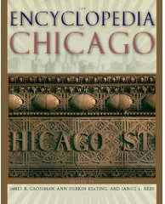
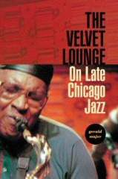


ALWAYS START
Encyclopedia & general reference books for starters
BOOKS or ARTICLES
By writers summarizing historians
By historians that summarize or synthesize other’s works
By historians on a narrow subject
Interviews with scholars, experts, museum docents, or others with second-hand knowledge
2. Take the Research Journey

Slide 30
“Follow the Footnotes”
In addition to background knowledge and reading others’ interpretations, secondary sources can lead to:
Other Key Secondary Sources
Where to find Primary Sources
and often will contain primary sources themselves!
2. Take the Research Journey

Slide 31
What are Primary Sources?
Materials made at the time, for the time, or persons who were witnesses or participants.
Primary sources are the “voices from the past” that make history come alive.
They are the historian’s EVIDENCE.
2. Take the Research Journey

Slide 32

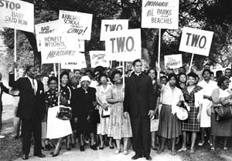
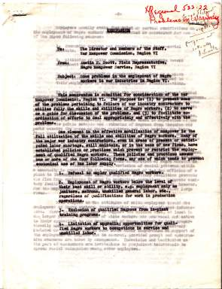
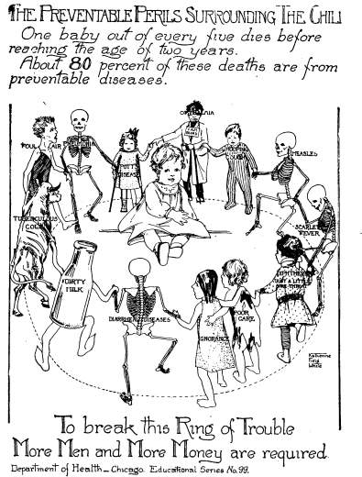
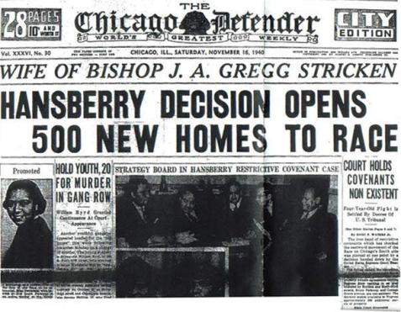
Speeches
Letters
Photographs
Posters, flyers
Diaries
Interviews – witness & participants
Newspapers, serials
Minutes or reports, government documents
2. Take the Research Journey

Slide 33
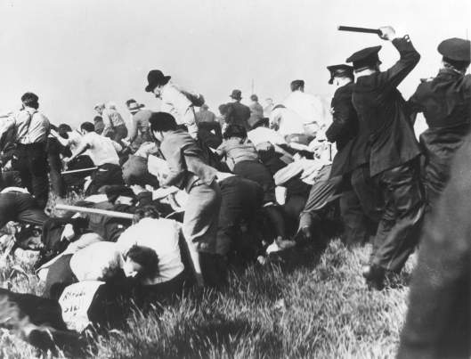
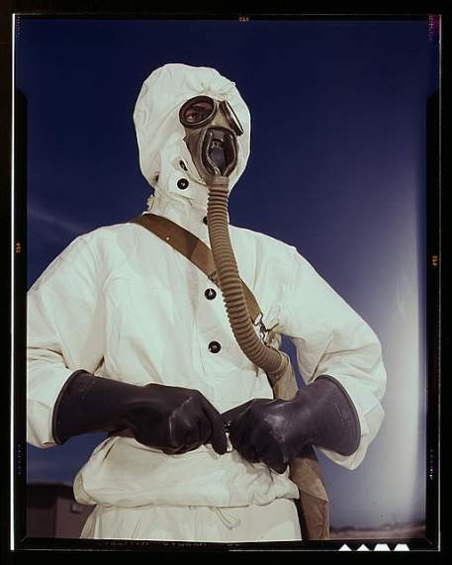
Photographs
2. Take the Research Journey

Slide 34
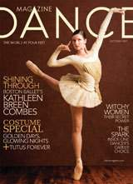
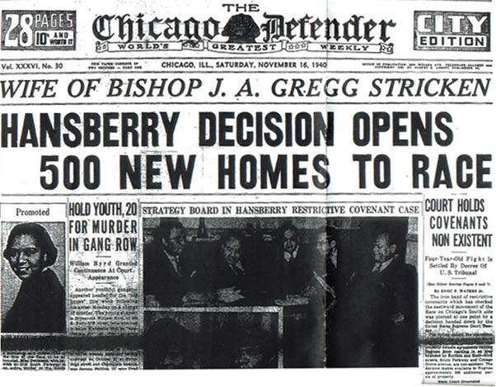
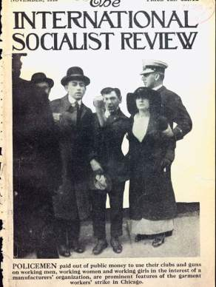

Newspapers, Periodicals, and Serials (Magazines)
2. Take the Research Journey

Slide 35
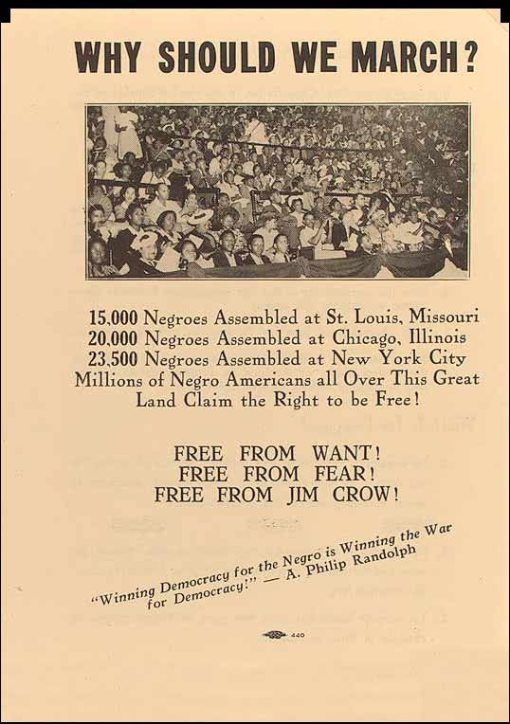
Flyers, Posters, and Cartoons
2. Take the Research Journey

Slide 36
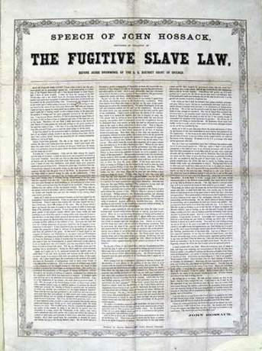
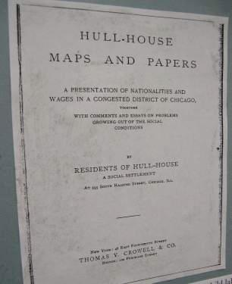
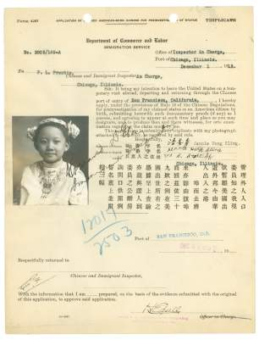
Reports, Government Documents, Laws, Trials, and Meeting Minutes
2. Take the Research Journey

Slide 37
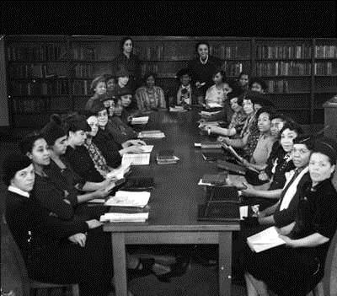
Also look for . . .
Speeches
Interviews
Oral Histories
Letters
Diaries
2. Take the Research Journey

Slide 38
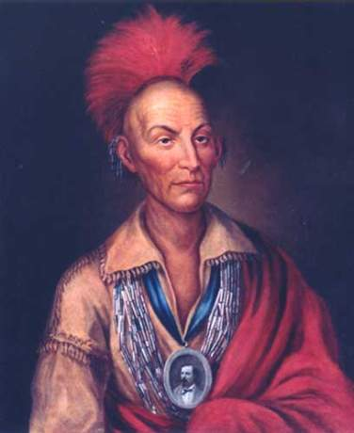
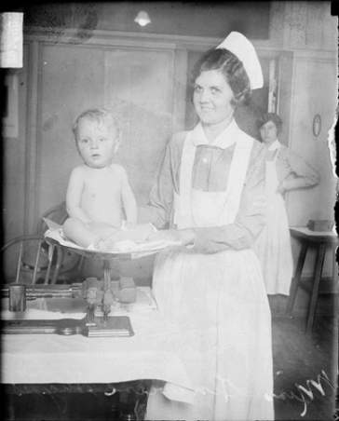

Primary or Secondary?
2. Take the Research Journey
For more on research resources, see the “Research Journey” Power Point
on the Research History → Research Journey section of the website.

Slide 39
WHERE CAN I FIND SOURCES?
Libraries
Archives/Special Collections
Neighborhoods
Organizations
Historic sites
Museums
Internet-Online Databases and Digital Collections
2. Take the Research Journey

Slide 40
You can make History Fair research one of the highlights of this school year!
Make connections to today– find out why your topic made a difference
Interview historians or experts in the topic
Interview people who were witnesses and participants
Research in special collections at universities
Visit historic sites and museums
2. Take the Research Journey

Slide 41
What makes a quality website for online primary and secondary sources?
Check out the Recommended Websites page on the History Fair’s website
.edu - look for digitized images and documents or articles/reports authored by professors. Avoid .edu websites made by other students
.gov - look for the real images and documents, authorized articles rather than “public relations pages”
.org - can be ok if it is credible and authored by an expert. You might need to dig to determine
Wikipedia? OK for background to get you going, but not for bibliographies.
.com - “un-authored sites” are not credible.
Note: Google, Yahoo, Ask.com are search engines,
not sources. Think of a search engine as a LIBRARY.
It is a place that has sources for you to find.
2. Take the Research Journey

Slide 42
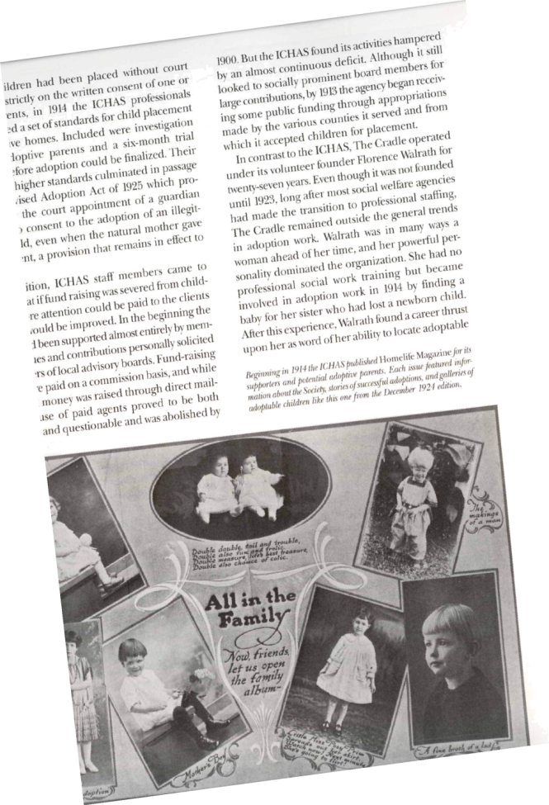
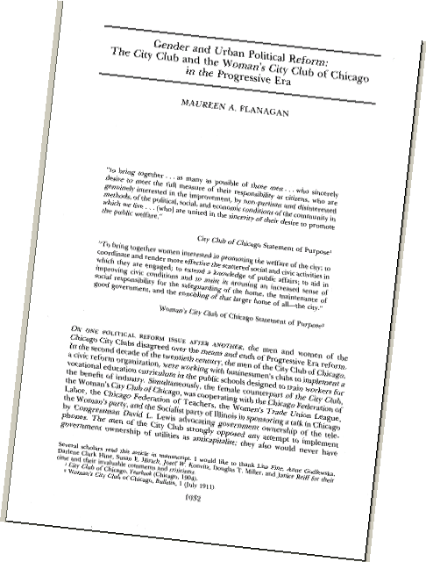
ONLINE databases for secondary sources are great! Sometimes the secondary sources will use primary sources that are hard to find elsewhere too.
J-STOR and “First Search” and other online databases are available at all CPL branches.
2. Take the Research Journey

Slide 43
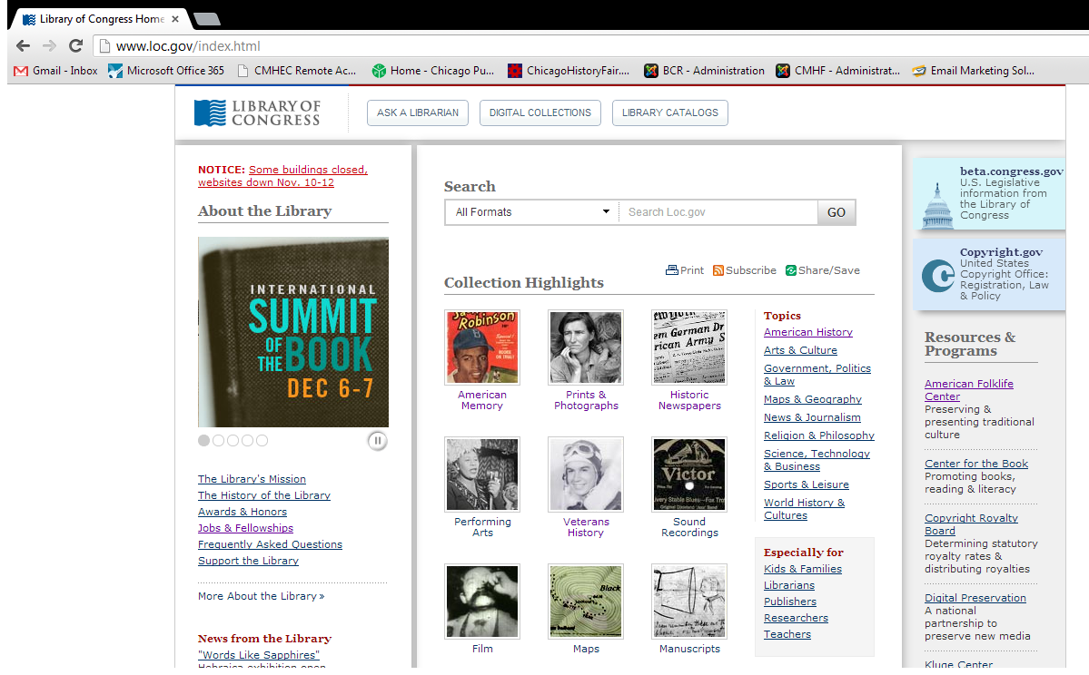
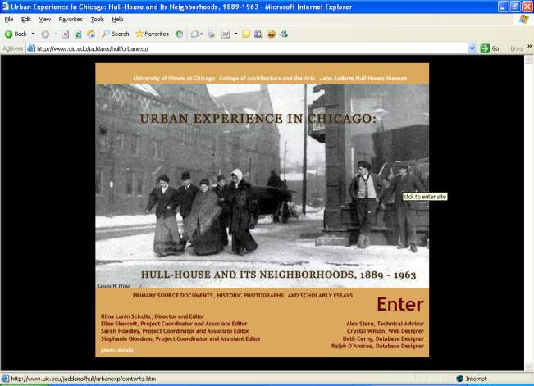
Superior websites give you real primary sources and are usually connected to universities, government, historical societies/museums, special collections.
2. Take the Research Journey

Slide 44
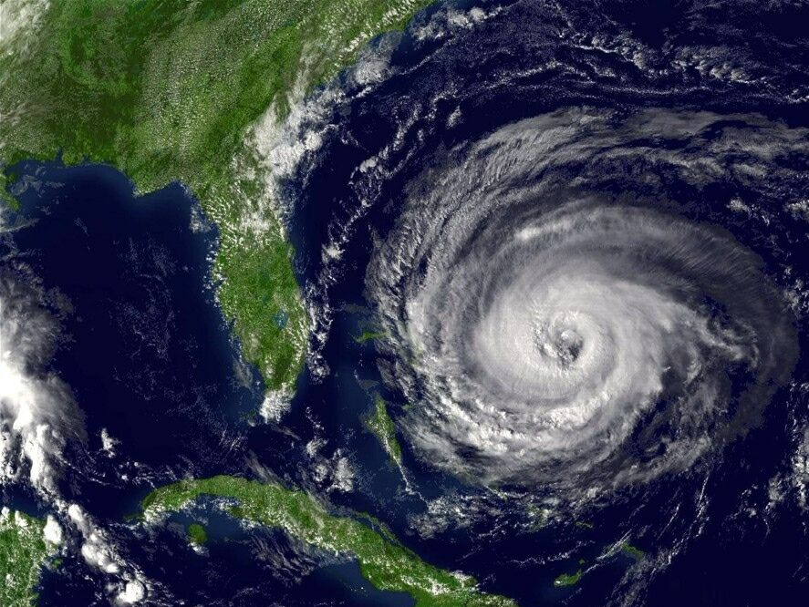
Keep track of all your sources as you are doing your research or you could get lost by the end of the journey.
RECORD ALL THE INFORMATION FOR YOUR BIBLIOGRAPHY WHILE YOU ARE LOOKING AT THE SOURCE!
2. Take the Research Journey

Slide 45
Just like historians, you will need to submit an Annotated Bibliography with your project:
A bibliography contains citations--the detailed publication information--about every source you used.
An annotation is your summary of the source and explanation of how it was used in your project.
(You will attach your Annotated Bibliography to the Summary Statement to give to your judges.)
2. Take the Research Journey

Slide 46
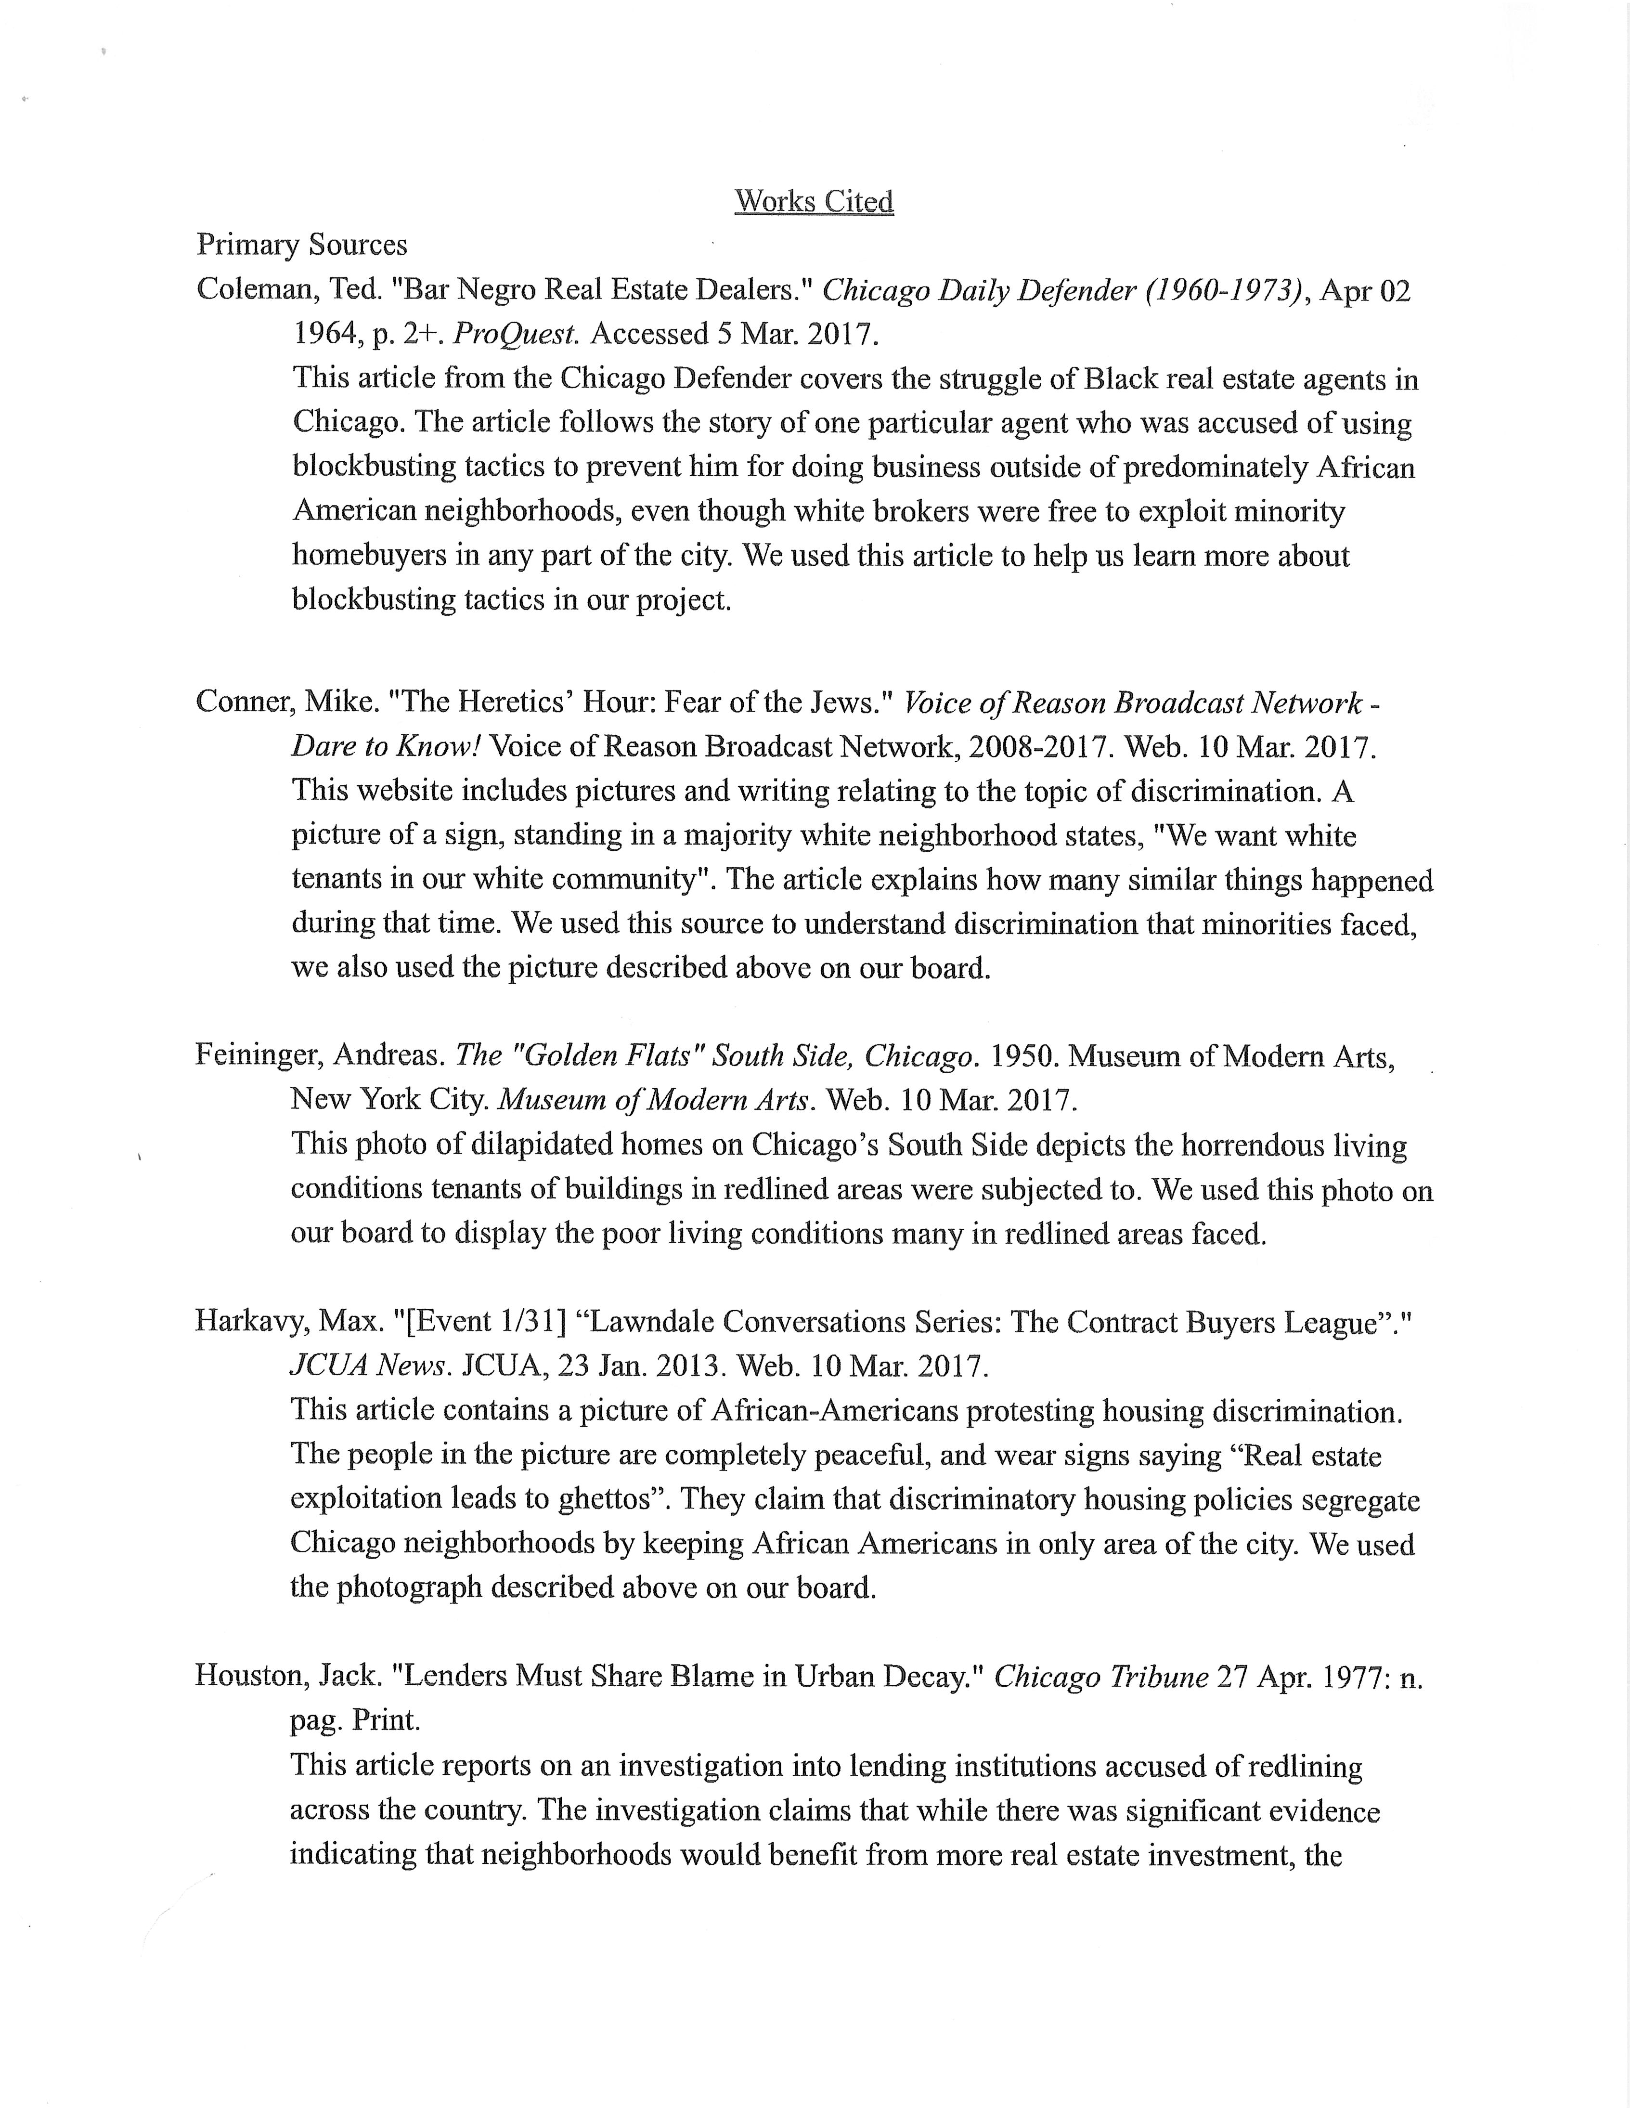
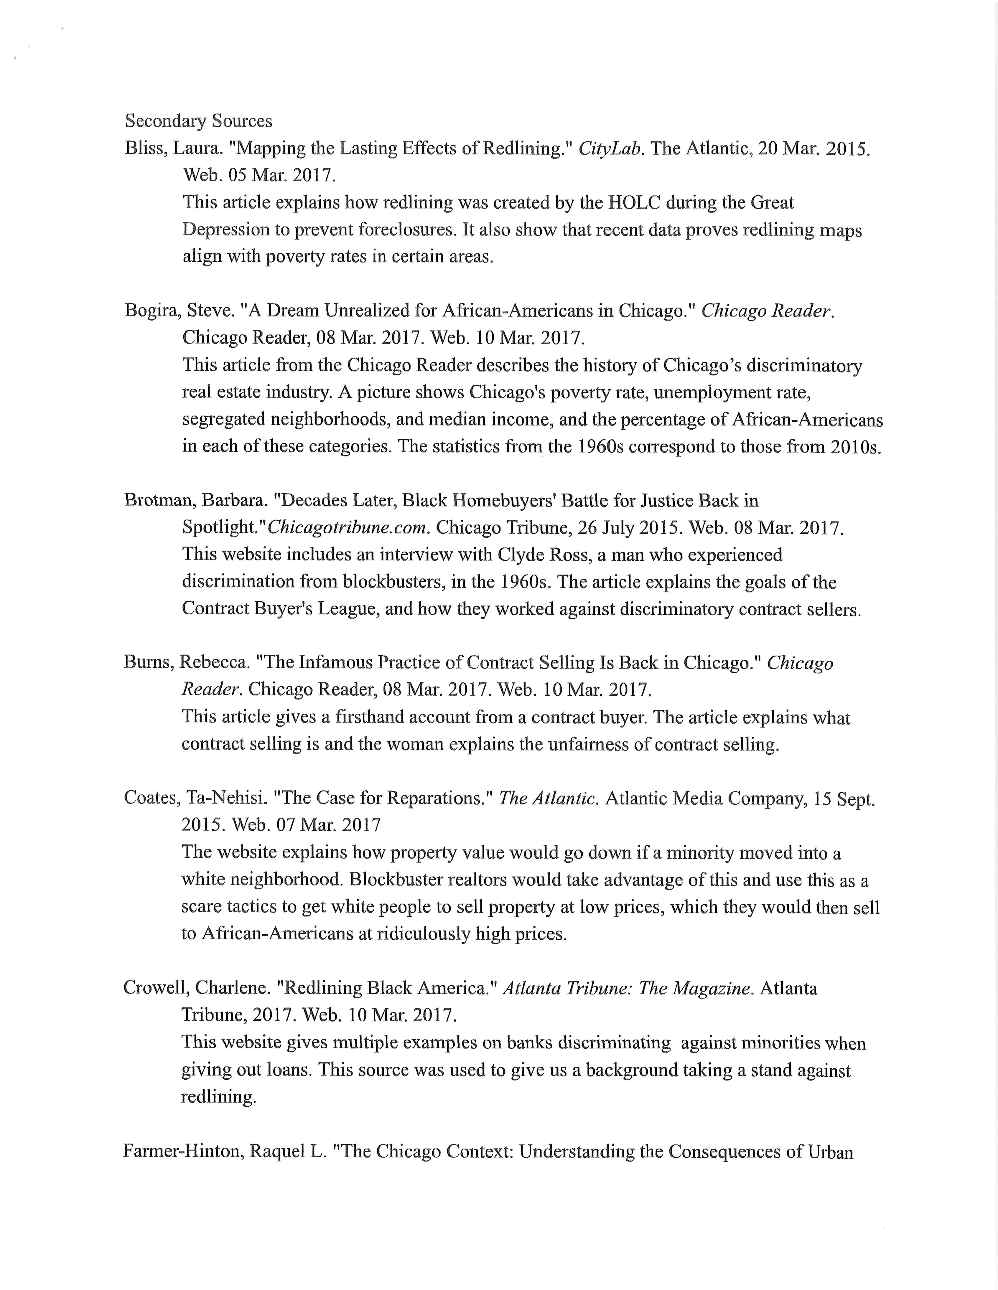
The annotation summarizes the source and explains how it was used in project.
Bibliographic Information may be either MLA or Turabian style. But be consistent.
Primary and Secondary Sources should be separated.
2. Take the Research Journey

Slide 47
Step 3
Learning How to Take Notes and Analyze Your Sources
What do I do with all of this?!?
3.
Analyze Your Sources

Slide 48
When you’re researching, organize what you are finding into six main areas:
Description: who, what, when, where
Historical context
What happened: how and why
Causes or contributing factors
What changed and why: effects & impact
Significance
Your notes = the information you are finding but ALSO your analysis of that information.
3.
Analyze Your Sources

Slide 49
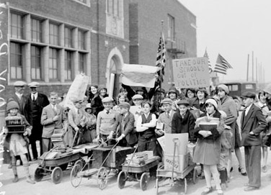
What is Context?
BACKGROUND
How were things done or thought before the change?
What else was going on at the same time that connects?
Who else was involved at the time?
What is the particular era in history called and how does your story fit in?
3.
Analyze Your Sources

Slide 50
What makes a topic “Historically Significant”?
Profound: How deeply people were or have been affected, lives changed?
Quantity: Did it affect many or just a few? Were the effects widespread or limited?
Durable: Did the effects last a long time or fade quickly?
Relevant: How does it contribute to our understanding of the past/present? Does it carry any meaning to historians today— can we learn from it?
3.
Analyze Your Sources

Slide 51
Once you’ve narrowed your topic, asked a historical question, and done more research, you will be able to write a “working“ thesis.
A thesis statement
tells us in one or two
sentences what you are going
to argue for in your project.
It is your answer to your historical question.
3.
Analyze Your Sources

Slide 52
From the Question to Thesis
Historical Question: “Did early Chicago TV produce any turning points?”
Draft Thesis: “The Chicago School of Television changed how people viewed television shows.”
Final Thesis: “The Chicago School of Television’s pioneering informal style in the ‘50s broke down barriers between the audience and performers. TV was no longer “radio with pictures” or a “play on air” but an entirely new way of interacting with unseen viewers. This was a turning point in the relationship between the new medium and its audience.”
3.
Analyze Your Sources

Slide 53
A Strong Thesis:
Takes a stand -- makes a specific argument or interpretation
Has a narrow and specific focus
Based on & can be supported with evidence
Explains historical impact, significance, or change over time, and
Can be communicated in one or two sentences.
3.
Analyze Your Sources

Slide 54
In other words . . .
What’s your point?
You know you have a thesis if someone else could make a different argument!
3.
Analyze Your Sources

Slide 55
Evaluate these theses:
After the 1919 riot the means of enforcing segregation became more accepted, more formal, often more violent, and completely legal.
Pesticides kill thousands of farm workers and must be stopped.
How did The Jungle make an impact on the foods we eat?
The Juvenile Court system was established to remove children from the adult criminal justice system and help them reform, but over the years it became a source of punishment and imprisonment.
3.
Analyze Your Sources
Richard J. Daley died in 1976.

Slide 56
Strong or weak thesis statements?
The Juvenile Court system was established to remove children from the adult criminal justice system and help them reform, but over the years it stopped focusing on rehabilitation of the children and became a source of punishment and imprisonment.
Since their introduction into farming by Mansuto in 1951, pesticides have killed thousands of farm workers and must be stopped.
3.
Analyze Your Sources

Slide 57
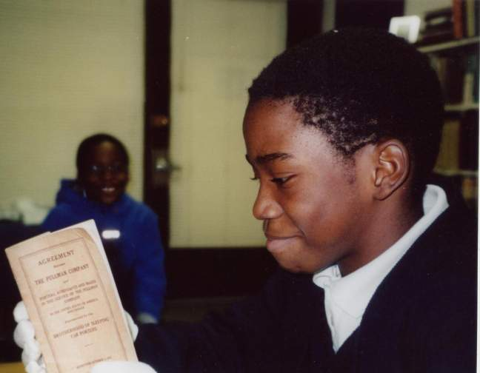
Analyze your sources because they will help you figure out your argument.
3.
Analyze Your Sources

Slide 58
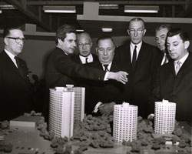
How does this source help me better understand my topic?
How does it relate to my thesis?
Analyze for
Author
Audience
Purpose
Context
Issue
Impact
Significance
Courtesy of the Chicago Housing Authority Archives
3.
Analyze Your Sources

Slide 59
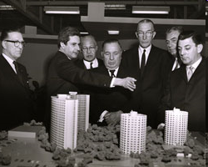
Try it for yourself!
Courtesy of the Chicago Housing Authority Archives
3.
Analyze Your Sources

Slide 60
The sources are evidence for your argument.
ANALYZE THIS PHOTOGRAPH:
How might it relate to either thesis?
What other sources would you need to find for either thesis?
Public housing failed under Mayor Richard J. Daley because it did not take into account tenants’ needs, but instead it focused on the warehousing of poor people into large units.
Mayor Richard J. Daley’s vision for public housing was to provide the kind of living spaces which would be on par with any middle class housing.
3.
Analyze Your Sources

Slide 61

Step 4
Thesis
Argument
Evidence (sources)
Conclusion
Putting it all Together
4.
Develop an Argument
Thinking like a historian & developing
your argument with evidence

Slide 62
Just like a historian, you will need to synthesize—or, connect your sources and information to make your historical argument that backs up your thesis.
4.
Develop an Argument

Slide 63
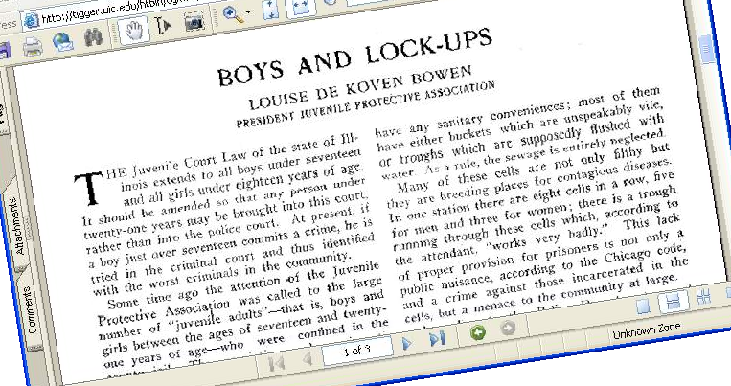
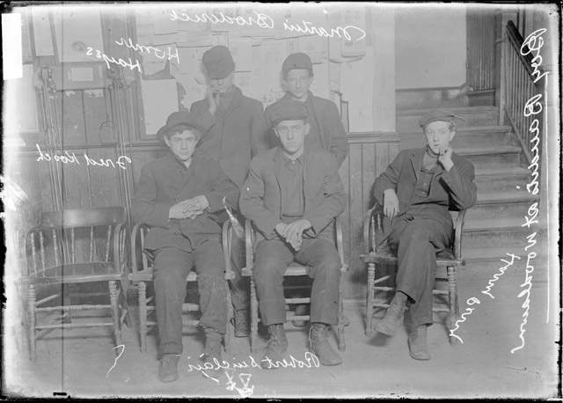
Make connections between the primary and secondary sources
4.
Develop an Argument

Slide 64
Just like a historian, keep these things in mind when making decisions about what is important enough to include in the story:
Causes and effects
What changed over time?
Why and how did events develop as they did?
What was the impact?
So what? Why does this history matter today?
4.
Develop an Argument

Slide 65
Support an argument with claims & evidence
Claims = each major point you make in order to have us understand and believe your argument which you will back up with evidence.
Every claim is supported by several sources.
Think of a claim as a “topic sentence.”
4.
Develop an Argument

Slide 66
Support an argument with claims & evidence (cont’d.)
Claim 1 –
The relevant background and historical context
Claim 2 – The set-up or development of the issue, problem
Introduction with thesis
Claims 3 & 4 - Central action – and main idea –what happens, why, how change occurred
Conclusion
(Wrap-up)
Claim 6 – Significance. Why it matters today, what was learned, how was “society” changed.
Claim 5 – Initial outcomes and impact
4.
Develop an Argument

Slide 67




The introduction is the ROAD MAP for the project’s entire argument. Your thesis is part of the introduction.
No matter what type of project you are doing, you will have an introduction to set-it up for your audience so they know what to look for in your project.
4.
Develop an Argument

Slide 68
LET’S ANALYZE THIS INTRODUCTION:
DOES IT HAVE ALL THE ELEMENTS THAT MAKE A STRONG INTRODUCTION?
The Northern Illinois Hospital and Asylum for the Insane was first proposed by the state legislature on April 16, 1869. and received its first patients on April 3, 1872. Before this time, many hospitals for the insane were like prisons, and the patients were treated like animals. The state wanted the hospital to have all of the newest technology for treatments and the best of living conditions for its patients and employees. Through the years it became clear that Elgin Mental Health Center was not helping its patients and sometimes even hurting them, so major changes were made to improve living conditions and treatment methods. The hospital became an example of both what to do and what not to do to improve mental institutions throughout the region and beyond.
4.
Develop an Argument
Context? Change over time? Historical significance? Thesis?

Slide 69
The Northern Illinois Hospital and Asylum for the Insane was first proposed by the state legislature on April 16, 1869 and received its first patients on April 3, 1872.
Before this time, many hospitals for the insane were like prisons, and the patients were treated like animals. The state wanted the hospital to have all of the newest technology for treatments and the best of living conditions for its patients and employees.
Through the years it became clear that Elgin Mental Health Center was not helping its patients and sometimes even hurting them, so major changes were made to improve living conditions and treatment methods.
The hospital became an example of both what to do and what not to do to improve mental institutions throughout the region and beyond.
CONTEXT
CHANGE OVER TIME
THESIS
HISTORICAL SIGNIFICANCE
4.
Develop an Argument

Slide 70
Your conclusion not only summarizes your argument, it tells us why this matters — what we can learn from history to understand today.
4.
Develop an Argument

Slide 71
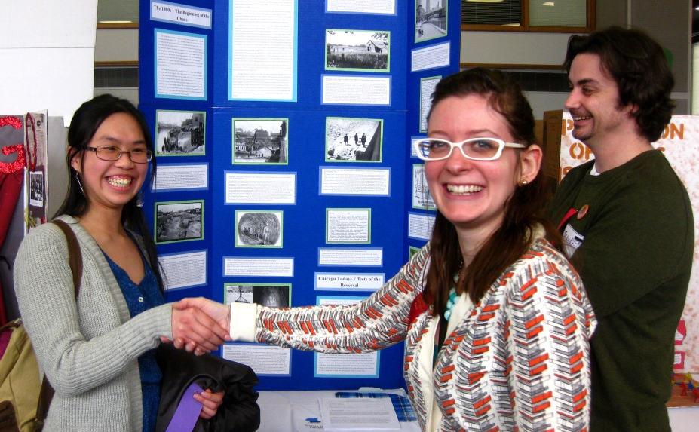
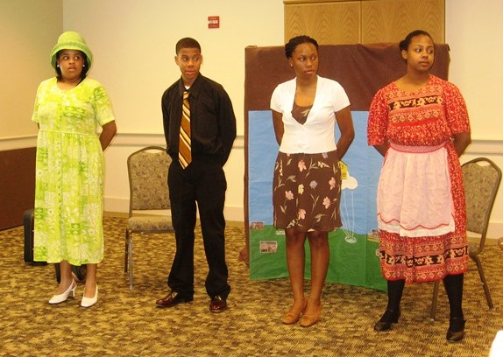

Step 5
Producing a History Fair Project
Visit the History Fair website
www.chicagohistory.org/historyfair
to find more guidelines, samples, and the rules for each category.
5.
Tell Us Your Story!

Slide 72
History Fair offers many ways to communicate your interpretation . . .
Choose a project that will communicate your topic most effectively.
* For example, a topic with few visuals would probably make a better paper than an exhibit board or website.
5.
Tell Us Your Story!

Slide 73

EXHIBITS
Lots of visual sources
Excellent, tight writing
Graphic design & creativity
Easy to follow
Organized like a mini-museum
Individuals or group
5.
Tell Us Your Story!
Exhibit Examples:
https://www.chicagohistory.org/historyfair/students/history-fair-examples/#exhibits

Slide 74
Use subheads and segments to move the story along
in each
section
INTRODUCTION IN EITHER PLACE.
Title on a header-board or make room at the top
IMPACT & LONG- LASTING SIGNIFICANCE
CONTEXT & BACKGROUND and set-up
MAIN IDEA & EVIDENCE
5.
Tell Us Your Story!
CONCLUSION

Slide 75


In an exhibit, the label tells the story—the surrounding sources provide the evidence and give detail to the story.
5.
Tell Us Your Story!

Slide 76


PERFORMANCES
Dramatic personality or enjoy talking with the public
Many sources are text, few visuals
Do not want to write a research paper
Want to try writing a script & block out moves
Willing to practice your script
Individuals or groups
Performance Examples:
https://www.chicagohistory.org/historyfair/students/history-fair-examples/#performances
5.
Tell Us Your Story!

Slide 77

WEBSITES
Learn how to build a website (no need to know HTML or CSS)
Graphic design
Many visual sources
Audio sources
Video footage sources
Interactivity
Individuals or group
Website Examples:
https://www.chicagohistory.org/historyfair/students/history-fair-examples/#websites
5.
Tell Us Your Story!

Slide 78

RESEARCH PAPERS
Best able to express ideas through writing
Few visual sources available
Individuals only
Research Paper Examples:
https://www.chicagohistory.org/historyfair/students/history-fair-examples/#papers
5.
Tell Us Your Story!

Slide 79


DOCUMENTARIES
Know how or would like to learn how to use recording and editing equipment
Want to write a script
Topic has lots of visual souces
Topic has audio sources (interviews, music)
Individuals or groups
Documentaries Examples:
https://www.chicagohistory.org/historyfair/students/history-fair-examples/#documentaries
5.
Tell Us Your Story!

Slide 80
A superior PRESENTATION is:
Clear about the thesis, argument, and conclusion,
Written so that the labels or the script are organized and easy to understand,
Interesting and creative.
Shows evidence that supports your case—everything relates to your thesis.
5.
Tell Us Your Story!

Slide 81

How will my project be evaluated?
Volunteer judges work together to review your project and evaluate it on:
Knowledge
Analysis
Sources
Presentation
5.
Tell Us Your Story!

Slide 82

The Summary Statement for Judges
Students state their thesis, summarize the main ideas of their project, and explain their process of creating their History Fair project.
Lots of penalty points if you do not have a Summary Statement & Annotated Bibliography!
5.
Tell Us Your Story!

Slide 83

Where can you go with your History Fair project?
5.
Tell Us Your Story!

Slide 84

School Fair
Citywide Fair
Finals (high school only)
State Expo
Public Presentations
National History Day
You may earn cash prizes and be eligible for a college scholarship!
5.
Tell Us Your Story!

Slide 85

Visit our website for more information, ideas, resources, and examples:
https://www.chicagohistory.org/historyfair/

Slide 86
Photo Credits
Slide 30: The Woodlawn Organization photograph (Industrial Area Foundation, Daley Library Special Collections Department, University of Illinois at Chicago); Memo (National Archives & Records Administration, Great Lakes Regional Center); Chicago World’s Fair poster, “Preventable Diseases” poster Board of Public Health Reports, Chicago Public Library; Chicago Defender front page
Slide 31: Chemical man photograph (FSA-OWI Photographs, American Memory, Library of Congress); Memorial Day Massacre photograph (Illinois Labor History Society).
Slide 33: “Why Should We March?” flier (African-American Odyssey, American Memory, Library of Congress);
Slide 34: Fugitive Slave broadside (Newberry Library); Naturalization application (National Archives & Records Administration, Great Lakes Regional Center); Hull House Report; Memo (National Archives & Records Administration, Great Lakes Regional Center)
Slide 35: Women intellectuals photograph (Hall Branch Archives 033, Vivian Harsh Collection, Chicago Public Library)
Slide 36: Portrait of Black Hawk (Courtesy Chicago History Museum); Nurse and infant photograph (DN-0085482, Chicago Daily News negatives collection, Chicago Historical Society); Newspaper article
Slide s 57-59: Daley and public housing photograph (www.roosevelt.edu/gagegallery/promise.htm)
Slide 63: Juveniles awaiting trial photograph (DN-0004676, Chicago Daily News negatives collection, Chicago Historical Society)

